Slide 1
Week 2 Review and Discussion

Slide 2
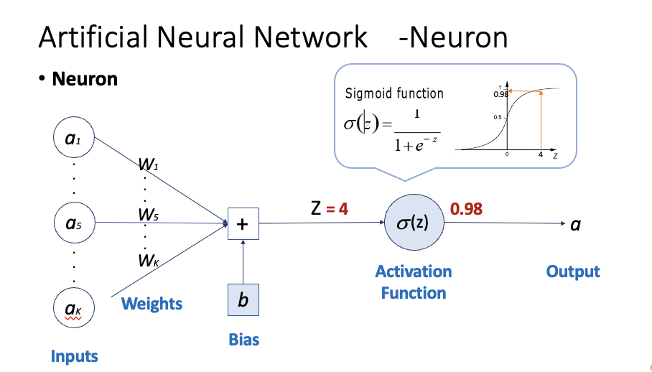
What are the three functions of a neuron?
Weigh
Sum
Transform

Slide 3
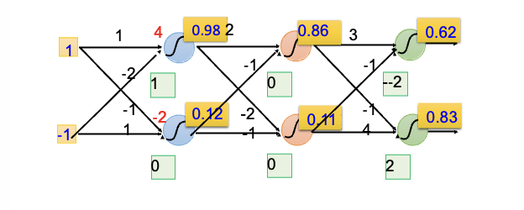
How does Neural Network make predictions?
Forward Propagation

Slide 4

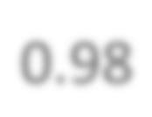



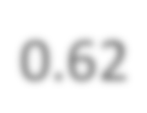
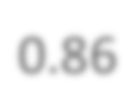





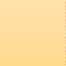

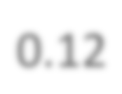


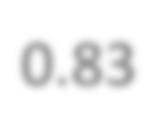
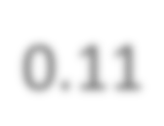






Artificial Neural Network -Structure
Fully Connected Feedforward Network
1
4
0.98 2
0.86
3
0.62
1
‐1
‐1
­‐2
1
0
-­‐2
­‐1
1
0.12 -­2
-­1
‐1
4
0.83
‐2
0.11
‐1
0
0
2

Slide 5
Artificial Neural Network -Structure
Fully Connected Feedforward Network

Slide 6
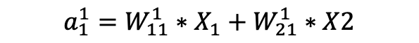
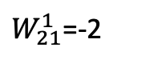
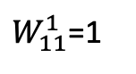
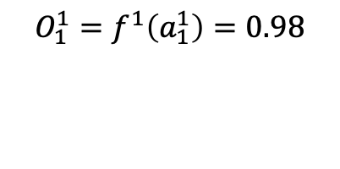
Artificial Neural Network -Structure
Fully Connected Feedforward Network
0.98
$W_{11}^{1}$=1
3
1
$W_{21}^{1}$=-2
‐1
Inputs
Activation
$${a_{1}^{1}=W}_{11}^{1}∗X_{1}+W_{21}^{1}∗X2$$
$${O_{1}^{1}=f}^{1}\left(a_{1}^{1}\right)=0.98$$
3 = 1*1+(-2)*(-1)
Notes:
W_{11}^1

Slide 7
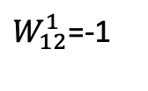
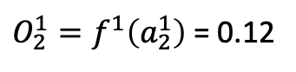
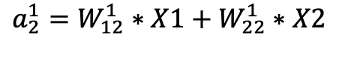
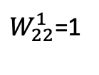
Artificial Neural Network -Structure
Fully Connected Feedforward Network
0.98
$W_{11}^{1}$=1
3
1
$W_{12}^{1}$=-1
0.12
$W_{21}^{1}$=-2
‐2
‐1
$W_{22}^{1}$=1
Inputs
Activation
$${a_{1}^{1}=W}_{11}^{1}∗X_{1}+W_{21}^{1}∗X2$$
$$a_{2}^{1}=W_{12}^{1}∗X1+W_{22}^{1}∗X2$$
$${O_{1}^{1}=f}^{1}\left(a_{1}^{1}\right)=0.98$$
3 = 1*1+(-2)*(-1)
-2 = (-1)*1 +1*(-1)
${O_{2}^{1}=f}^{1}\left(a_{2}^{1}\right)$ = 0.12
Notes:
W_{11}^1

Slide 8
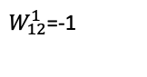
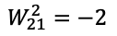
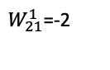
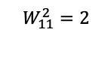
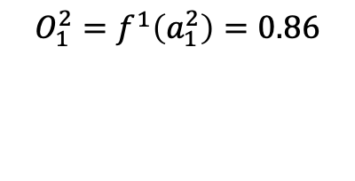
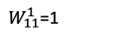
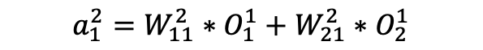
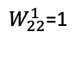
Artificial Neural Network -Structure
Fully Connected Feedforward Network
0.98
0.86
$W_{11}^{1}$=1
3
1
$$W_{11}^{2}=2$$
$W_{12}^{1}$=-1
0.12
$W_{21}^{1}$=-2
‐2
$$W_{21}^{2}=−2$$
‐1
$W_{22}^{1}$=1
Inputs
Activation
$${a_{1}^{2}=W}_{11}^{2}∗O_{1}^{1}+W_{21}^{2}∗O_{2}^{1}$$
$${O_{1}^{2}=f}^{1}\left(a_{1}^{2}\right)=0.86$$
1.72 = 2*0.98 + (-2)*0.12
Notes:
W_{11}^1

Slide 9
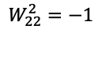
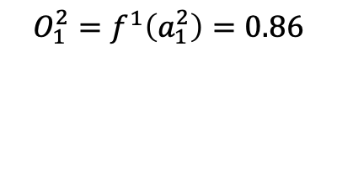
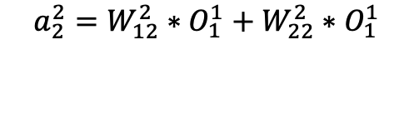
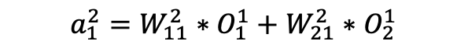
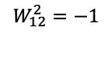
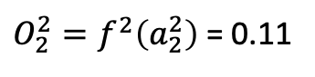
Artificial Neural Network -Structure
Fully Connected Feedforward Network
0.98
0.86
$W_{11}^{1}$=1
3
1
$$W_{11}^{2}=2$$
$W_{12}^{1}$=-1
$$W_{12}^{2}=−1$$
0.12
0.11
$W_{21}^{1}$=-2
‐2
$$W_{21}^{2}=−2$$
‐1
$W_{22}^{1}$=1
$$W_{22}^{2}=−1$$
Inputs
Activation
$${a_{1}^{2}=W}_{11}^{2}∗O_{1}^{1}+W_{21}^{2}∗O_{2}^{1}$$
$$a_{2}^{2}=W_{12}^{2}∗O_{1}^{1}+W_{22}^{2}∗O_{1}^{1}$$
$${O_{1}^{2}=f}^{1}\left(a_{1}^{2}\right)=0.86$$
1.72 = 2*0.98 + (-2)*0.12
-1.1 = (-1)*0.98 + (-1)*0.12
${O_{2}^{2}=f}^{2}\left(a_{2}^{2}\right)$ = 0.11
Notes:
W_{11}^1

Slide 10
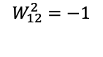
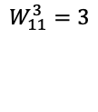
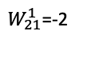
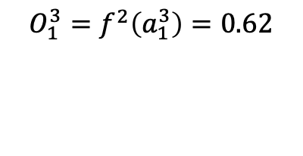
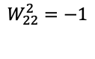
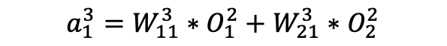
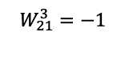
Artificial Neural Network -Structure
Fully Connected Feedforward Network
0.98
0.86
0.62
$W_{11}^{1}$=1
3
$$W_{11}^{3}=3$$
1
$$W_{11}^{2}=2$$
$W_{12}^{1}$=-1
$$W_{12}^{2}=−1$$
0.12
0.11
$$W_{21}^{3}=−1$$
$W_{21}^{1}$=-2
‐2
$$W_{21}^{2}=−2$$
‐1
$W_{22}^{1}$=1
$$W_{22}^{2}=−1$$
Inputs
Activation
$${a_{1}^{3}=W}_{11}^{3}∗O_{1}^{2}+W_{21}^{3}∗O_{2}^{2}$$
$${O_{1}^{3}=f}^{2}\left(a_{1}^{3}\right)=0.62$$
2.74 = 3*0.86+(-1)*0.11
Notes:
W_{11}^1

Slide 11
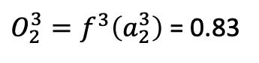
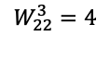
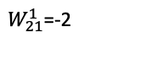
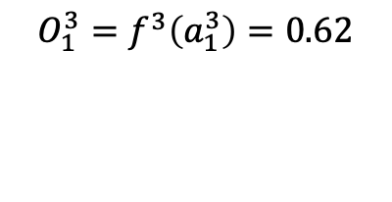
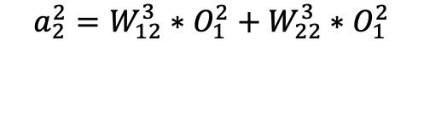
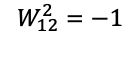
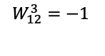
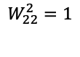
Artificial Neural Network -Structure
Fully Connected Feedforward Network
0.98
0.86
0.62
$W_{11}^{1}$=1
3
$$W_{11}^{3}=3$$
1
$$W_{11}^{2}=2$$
$W_{12}^{1}$=-1
$$W_{12}^{3}=−1$$
$$W_{12}^{2}=−1$$
0.12
0.11
$$W_{21}^{3}=−1$$
0.83
$W_{21}^{1}$=-2
‐2
$$W_{21}^{2}=−2$$
‐1
$W_{22}^{1}$=1
$$W_{22}^{2}=1$$
$$W_{22}^{3}=4$$
Inputs
Activation
$${a_{1}^{3}=W}_{11}^{3}∗O_{1}^{2}+W_{21}^{3}∗O_{2}^{2}$$
$$a_{2}^{2}=W_{12}^{3}∗O_{1}^{2}+W_{22}^{3}∗O_{1}^{2}$$
$${O_{1}^{3}=f}^{3}\left(a_{1}^{3}\right)=0.62$$
2.47 = 3*0.86+(-1)*0.11
-0.42 = (-1)*0.86+4*0.11
${O_{2}^{3}=f}^{3}\left(a_{2}^{3}\right)$ = 0.83
Notes:
W_{11}^1

Slide 12
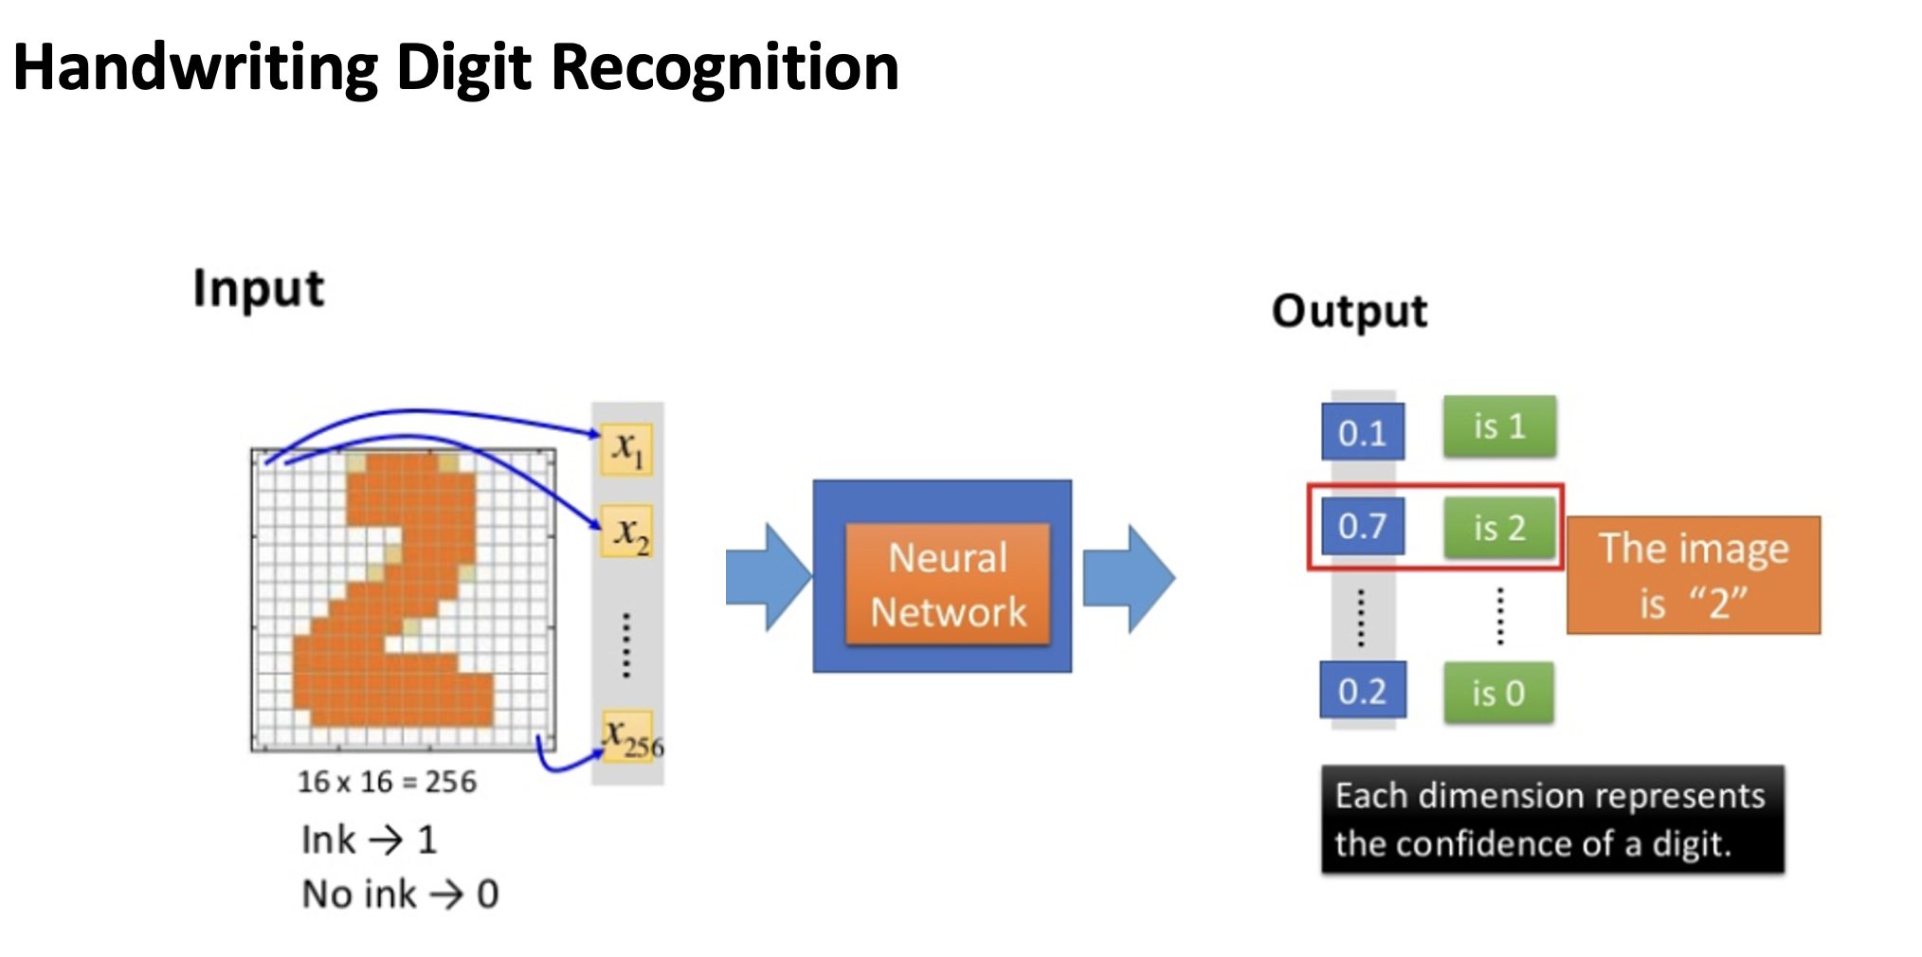

Slide 13
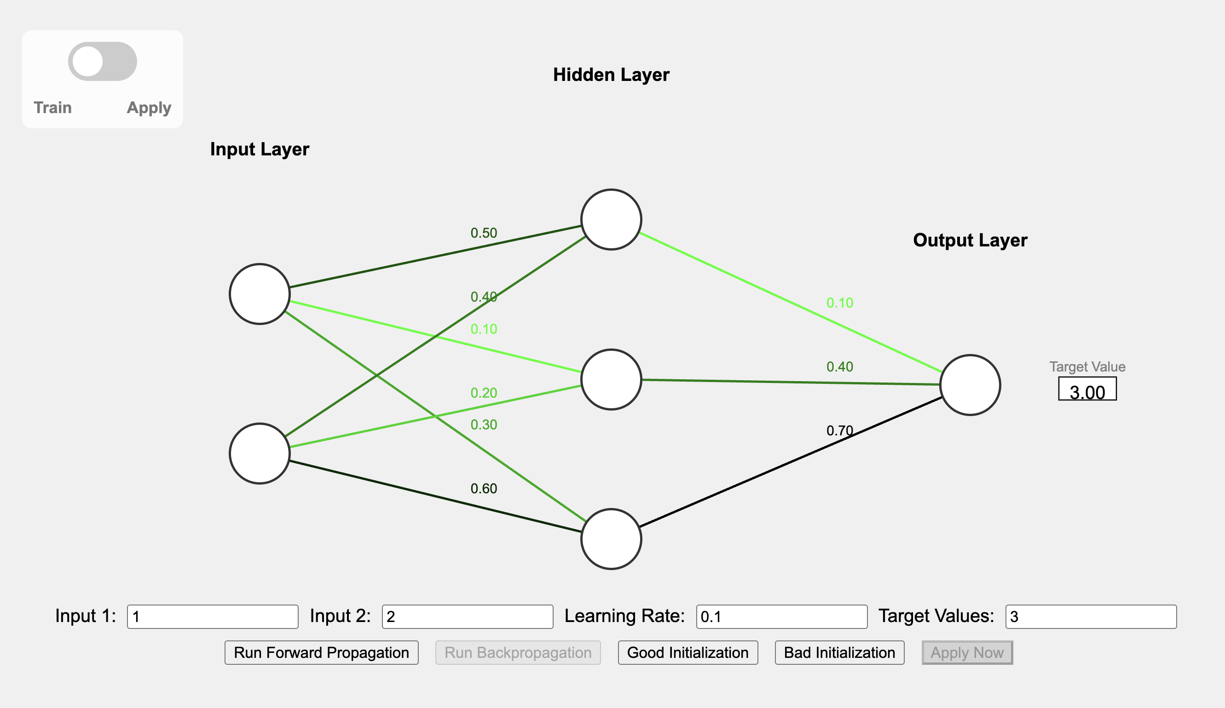
https://neural.cdhai.com/

Slide 14
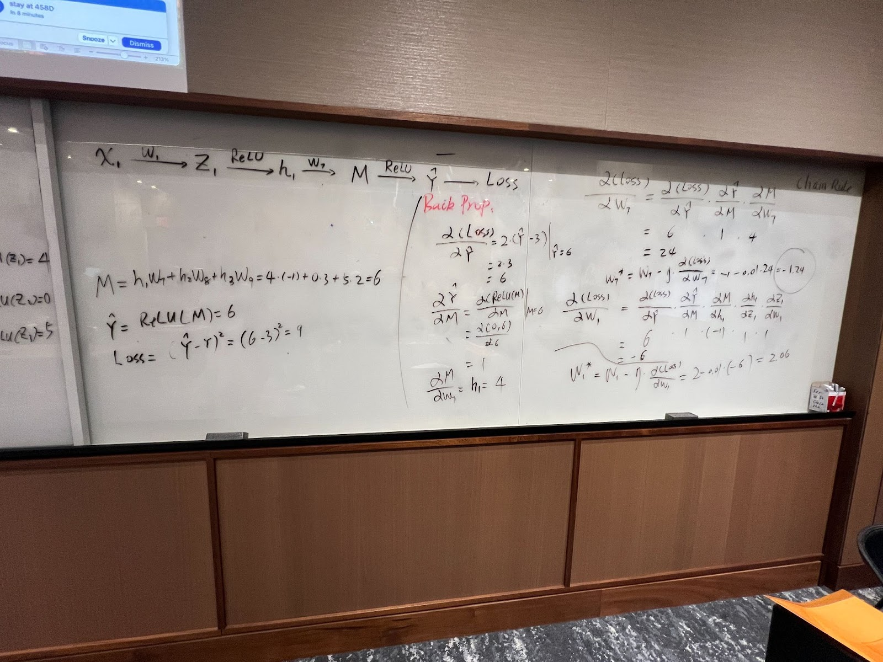
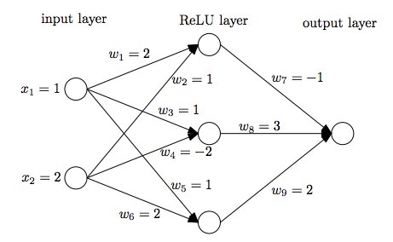

Slide 15


Which step will adjust Neural Network parameters?
Back propagation

Slide 16




Assignment 2 Review

